Slide 1
Different Techniques used in Dimensional Reduction

Slide 2
Dimensionality Reduction Methods
There are several dimensionality reduction methods that can be used with different types of data for different requirements.
Dimensionality reduction can be done in two different ways:
By only keeping the most relevant variables from the original dataset (this technique is called feature selection)
By finding a smaller set of new variables, each being a combination of the input variables, containing basically the same information as the input variables (this technique is called dimensionality reduction)

Slide 3
There are mainly two types of dimensionality reduction methods.
Both methods reduce the number of dimensions but in different ways.
One type of method only keeps the most important features in the dataset and removes the redundant features.
There is no transformation applied to the set of features. Backward elimination, Forward selection and Random forests are examples of this method.
The other method finds a combination of new features.
An appropriate transformation is applied to the set of features.
The new set of features contains different values instead of the original values.
Principal Component Analysis (PCA), Factor Analysis (FA), Linear Discriminant Analysis (LDA) and Truncated Singular Value Decomposition (SVD) are examples

Slide 4
Techniques of Dimensionality Reduction
Principal Component Analysis
Backward Elimination
Forward Selection
Missing Value Ratio
Low Variance Filter
High Correlation Filter

Slide 5
Missing Value Ratio
If a dataset has too many missing values, then we drop those variables as they do not carry much useful information.
To perform this, we can set a threshold level, and if a variable has missing values more than that threshold, we will drop that variable.
The higher the threshold value, the more efficient the reduction.
However, what to do when there are too many missing values, say, over 50%?
In such situations, you can set a threshold value and use the missing values ratio method.
The higher the threshold value, the more aggressive will be the dimensionality reduction.
If the percentage of missing values in a variable exceeds the threshold, you can drop the variable.

Slide 6
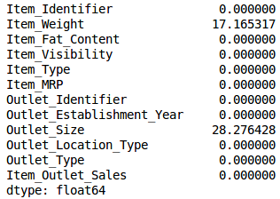
# import required libraries
import pandas as pd
import numpy as np
import matplotlib.pyplot as plt
#read the data train=pd.read_csv("Train_UWu5bXk.csv")
# checking the percentage of missing values in each variable train.isnull().sum()/len(train)*100

Slide 7
As you can see in the above table, there aren’t too many missing values (just 2 variables have them actually).
We can impute the values using appropriate methods, or we can set a threshold of, say 20%, and remove the variable having more than 20% missing values.
Let’s look at how this can be done in Python:
# saving missing values in a variable
a = train.isnull().sum()/len(train)*100
# saving column names in a variable
variables = train.columns
variable = [ ]
for i in range(0,12):
if a[i]<=20: #setting the threshold as 20%
variable.append(variables[i])
So the variables to be used are stored in “variable”, which contains only those features where the missing values are less than 20%.

Slide 8
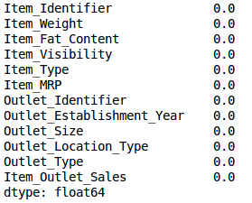
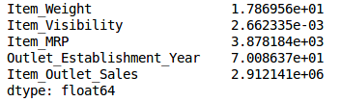
Low Variance Filter
Consider a variable in our dataset where all the observations have the same value, say 1.
If we use this variable, do you think it can improve the model we will build?
The answer is no, because this variable will have zero variance.
train['Item_Weight'].fillna(train['Item_Weight'].median(), inplace=True)
train['Outlet_Size'].fillna(train['Outlet_Size'].mode()[0], inplace=True)
#Let’s check whether all the missing values have been filled
train.isnull().sum()/len(train)*100
#Now let’s calculate the variance of all the numerical variables.
train.var()

Slide 9
As the above output shows, the variance of Item_Visibility is very less as compared to the other variables.
We can safely drop this column.
This is how we apply low variance filter.
numeric = train[['Item_Weight', 'Item_Visibility', 'Item_MRP', 'Outlet_Establishment_Year']]
var = numeric.var()
numeric = numeric.columns
variable = [ ]
for i in range(0,len(var)):
if var[i]>=10: #setting the threshold as 10%
variable.append(numeric[i+1])
The above code gives us the list of variables that have a variance greater than 10

Slide 10
High Correlation filter
High correlation between two variables means they have similar trends and are likely to carry similar information.
This can bring down the performance of some models drastically (linear and logistic regression models, for instance).
We can calculate the correlation between independent numerical variables that are numerical in nature.
If the correlation coefficient crosses a certain threshold value, we can drop one of the variables (dropping a variable is highly subjective and should always be done keeping the domain in mind).

Slide 11
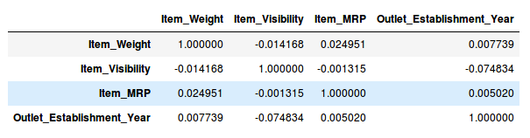
Let’s perform the correlation calculation in Python.
We will drop the dependent variable (Item_Outlet_Sales) first and save the remaining variables in a new dataframe (df).
df=train.drop('Item_Outlet_Sales', 1)
df.corr()
We don’t have any variables with a high correlation in our dataset.
Generally, if the correlation between a pair of variables is greater than 0.5-0.6, we should seriously consider dropping one of those variables.

Slide 12
Backward Feature Elimination
Follow the below steps to understand and use the ‘Backward Feature Elimination’ technique:
We first take all the n variables present in our dataset and train the model using them
We then calculate the performance of the model
Now, we compute the performance of the model after eliminating each variable (n times), i.e., we drop one variable every time and train the model on the remaining n-1 variables
We identify the variable whose removal has produced the smallest (or no) change in the performance of the model, and then drop that variable
Repeat this process until no variable can be dropped
This method can be used when building Linear Regression or Logistic Regression models.

Slide 13
Forward Feature Selection
This is the opposite process of the Backward Feature Elimination we saw above.
Instead of eliminating features, we try to find the best features which improve the performance of the model.
This technique works as follows:
We start with a single feature. Essentially, we train the model n number of times using each feature separately
The variable giving the best performance is selected as the starting variable
Then we repeat this process and add one variable at a time. The variable that produces the highest increase in performance is retained
We repeat this process until no significant improvement is seen in the model’s performance

Slide 14
Principal Component Analysis (PCA)
Principal Component Analysis is one of the leading linear techniques of dimensionality reduction.
This method performs a direct mapping of the data to a lesser dimensional space in a way that maximizes the variance of the data in the low-dimensional representation
Principal Component Analysis is a statistical process that converts the observations of correlated features into a set of linearly uncorrelated features with the help of orthogonal transformation.
These new transformed features are called the Principal Components.
It is one of the popular tools that is used for exploratory data analysis and predictive modeling.

Slide 15
PCA works by considering the variance of each attribute because the high attribute shows the good split between the classes, and hence it reduces the dimensionality.
Some real-world applications of PCA are image processing, movie recommendation system, optimizing the power allocation in various communication channels.
The new features are orthogonal, which means that they are uncorrelated.
Furthermore, they are ranked in order of their "explained variance."
The first principal component (PC1) explains the most variance in your dataset, PC2 explains the second-most variance, and so on.
Therefore, you can reduce dimensionality by limiting the number of principal components to keep based on cumulative explained variance.
For example, you might decide to keep only as many principal components as needed to reach a cumulative explained variance of 90%.
You should always normalize your dataset before performing PCA because the transformation is dependent on scale.
If you don't, the features that are on the largest scale would dominate your new principal components.

